Slide 1
Principles of Biostatistics ANOVA

Slide 2
Table shows weight gains for mice on 3 diets.
Test the following hypothesis at the α = 0.05 sig level.
Diet | Weight Gain (grams)
Standard | 9 | 10 | 10 | 10 | 8
Junk Food | 10 | 10 | 13 | 13 | 12
Organic | 9 | 10 | 12 | 9 | 10

Slide 3
Table shows weight gains for mice on 3 diets.
Test the following hypothesis at the α = 0.05 sig level.
Diet | Weight Gain (grams)
Standard | 9 | 10 | 10 | 10 | 8
Junk Food | 10 | 10 | 13 | 13 | 12
Organic | 9 | 10 | 12 | 9 | 10
ANOVA (Analysis of Variance)
Assumptions:
Samples are independent (within and among groups)
Population variances are equal
Populations are normally distributed

Slide 4
Table shows weight gains for mice on 3 diets.
Test the following hypothesis at the α = 0.05 sig level.
Diet | Weight Gain (grams) |  |  |  |  | Mean
Standard | 9 | 10 | 10 | 10 | 8 | 9.4
Junk Food | 10 | 10 | 13 | 13 | 12 | 11.6
Organic | 9 | 10 | 12 | 9 | 10 | 10
 |  |  |  |  |  | 10.33

Slide 5
Table shows weight gains for mice on 3 diets.
Test the following hypothesis at the α = 0.05 sig level.
Diet | Weight Gain (grams) |  |  |  |  | Mean
Standard | 9 | 10 | 10 | 10 | 8 | 9.4
Junk Food | 10 | 10 | 13 | 13 | 12 | 11.6
Organic | 9 | 10 | 12 | 9 | 10 | 10
 |  |  |  |  |  | 10.33
Diet | Square Deviations (within groups)
Standard | (9-9.4)² | (10-9.4)² | (10-9.4)² | (10-9.4)² | (8-9.4)²
Junk Food | (10-11.6)² | (10-11.6)² | (13-11.6)² | (13-11.6)² | (12-11.6)²
Organic | (9-10)² | (10-10)² | (12-10)² | (9-10)² | (10-10)²
Diet | Square Deviations (within groups)
Standard | 0.16 | 0.36 | 0.36 | 0.36 | 1.96
Junk Food | 2.56 | 2.56 | 1.96 | 1.96 | 0.16
Organic | 1 | 0 | 4 | 1 | 0

Slide 6
Table shows weight gains for mice on 3 diets.
Test the following hypothesis at the α = 0.05 sig level.
Diet | Weight Gain (grams) |  |  |  |  | Mean
Standard | 9 | 10 | 10 | 10 | 8 | 9.4
Junk Food | 10 | 10 | 13 | 13 | 12 | 11.6
Organic | 9 | 10 | 12 | 9 | 10 | 10
 |  |  |  |  |  | 10.33
Diet | Square Deviations (within groups)
Standard | 0.16 | 0.36 | 0.36 | 0.36 | 1.96
Junk Food | 2.56 | 2.56 | 1.96 | 1.96 | 0.16
Organic | 1 | 0 | 4 | 1 | 0

Slide 7
Table shows weight gains for mice on 3 diets.
Test the following hypothesis at the α = 0.05 sig level.
Diet | Weight Gain (grams) |  |  |  |  | Mean
Standard | 9 | 10 | 10 | 10 | 8 | 9.4
Junk Food | 10 | 10 | 13 | 13 | 12 | 11.6
Organic | 9 | 10 | 12 | 9 | 10 | 10
 |  |  |  |  |  | 10.33
Diet | Square Deviations (between groups)
Standard | (9.4-10.33)²
Junk Food | (11.6-10.33)²
Organic | (10-10.33)²
Diet | Square Deviations (between groups)
Standard | 0.87
Junk Food | 1.60
Organic | 0.11

Slide 8
Table shows weight gains for mice on 3 diets.
Test the following hypothesis at the α = 0.05 sig level.
Diet | Weight Gain (grams) |  |  |  |  | Mean
Standard | 9 | 10 | 10 | 10 | 8 | 9.4
Junk Food | 10 | 10 | 13 | 13 | 12 | 11.6
Organic | 9 | 10 | 12 | 9 | 10 | 10
 |  |  |  |  |  | 10.33
Diet | Square Deviations (between groups)
Standard | 0.87
Junk Food | 1.60
Organic | 0.11

Slide 9
Table shows weight gains for mice on 3 diets.
Test the following hypothesis at the α = 0.05 sig level.
Diet | Weight Gai (grams) |  |  |  |  | Mean
Standard | 9 | 10 | 10 | 10 | 8 | 9.4
Junk Food | 10 | 10 | 13 | 13 | 12 | 11.6
Organic | 9 | 10 | 12 | 9 | 10 | 10
 |  |  |  |  |  | 10.33

Slide 10
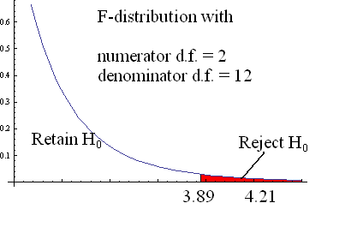
Table shows weight gains for mice on 3 diets.
Test the following hypothesis at the α = 0.05 sig level.
Diet | Weight Gai (grams) |  |  |  |  | Mean
Standard | 9 | 10 | 10 | 10 | 8 | 9.4
Junk Food | 10 | 10 | 13 | 13 | 12 | 11.6
Organic | 9 | 10 | 12 | 9 | 10 | 10
 |  |  |  |  |  | 10.33

Slide 11
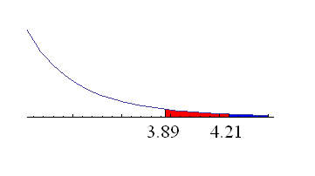
Calculating the p-value

Slide 12
Post-hoc Tests
Diet | Weight Gain (grams)
Standard | 9 | 10 | 10 | 10 | 8
Junk Food | 10 | 10 | 13 | 13 | 12
Organic | 9 | 10 | 12 | 9 | 10

Slide 13
Post-hoc Tests
Diet | Weight Gain (grams)
Standard | 9 | 10 | 10 | 10 | 8
Junk Food | 10 | 10 | 13 | 13 | 12
Organic | 9 | 10 | 12 | 9 | 10

Slide 14
Post-hoc Tests
Diet | Weight Gain (grams)
Standard | 9 | 10 | 10 | 10 | 8
Junk Food | 10 | 10 | 13 | 13 | 12
Organic | 9 | 10 | 12 | 9 | 10
Assumptions
Samples are independent
Population variances are equal
Populations are normally distributed
Not paired samples

Slide 15
Estimating the Pooled Variance
Diet | Weight Gain (grams) |  |  |  |  | St Dev
Standard | 9 | 10 | 10 | 10 | 8 | 0.89
Junk Food | 10 | 10 | 13 | 13 | 12 | 1.52
Organic | 9 | 10 | 12 | 9 | 10 | 1.22

Slide 16
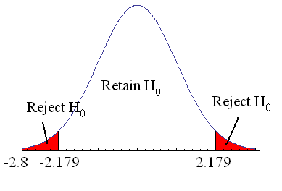
Back to the Post-hoc Tests
Diet | Weight Gain (grams) |  |  |  |  | Mean
Standard | 9 | 10 | 10 | 10 | 8 | 9.4
Junk Food | 10 | 10 | 13 | 13 | 12 | 11.6
Organic | 9 | 10 | 12 | 9 | 10 | 10

Slide 17
Post-hoc Confidence Interval
Diet | Weight Gain (grams) |  |  |  |  | Mean
Standard | 9 | 10 | 10 | 10 | 8 | 9.4
Junk Food | 10 | 10 | 13 | 13 | 12 | 11.6
Organic | 9 | 10 | 12 | 9 | 10 | 10

Slide 18
Post-hoc Summary
Diet | Weight Gain (grams) |  |  |  |  | Mean
Standard | 9 | 10 | 10 | 10 | 8 | 9.4
Junk Food | 10 | 10 | 13 | 13 | 12 | 11.6
Organic | 9 | 10 | 12 | 9 | 10 | 10
t-statistic | Decision
-2.81 | Reject H₀
-0.77 | Retain H₀
2.04 | Retain H₀
Confidence Interval
(-3.91, -0.49)
(-2.31, 1.11)
(-0.11, 3.31)

Slide 19
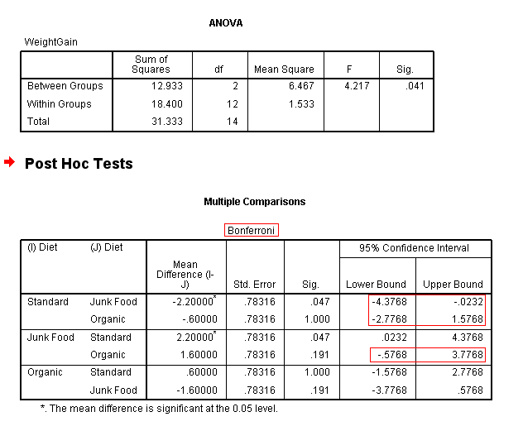
SPSS Output

Slide 20
Bonferroni’s Correction
Example
A study has 3 groups.
3 comparisons must be made.
1 to 2, 1 to 3, 2 to 3
If the pairwise error rate is 5%,
approximate the overall error rate
Answer: 15%

Slide 21
Bonferroni’s Correction
Example
A study has 4 groups.
6 comparisons must be made.
1 to 2, 1 to 3, 1 to 4,
2 to 3, 2 to 4, 3 to 4
If the pairwise error rate is 5%,
approximate the overall error rate
Answer: 30%

Slide 22
Bonferroni’s Correction
Example
A study has 3 groups.
3 comparisons must be made.
1 to 2, 1 to 3, 2 to 3
If the overall error rate is 5%,
approximate the pairwise error rate
Answer:

Slide 23
Bonferroni’s Correction
Example
A study has 4 groups.
6 comparisons must be made.
1 to 2, 1 to 3, 1 to 4,
2 to 3, 2 to 4, 3 to 4
If the overall error rate is 5%,
approximate the pairwise error rate
Answer:

Slide 24
Formula for # of Comparisons

Slide 25
Post-hoc Confidence Intervals with Bonferroni’s Correction

Slide 26
Post-hoc Confidence Intervals with Bonferroni’s Correction

Slide 27
Post-hoc Confidence Intervals with Bonferroni’s Correction
Diet | Weight Gain (grams) |  |  |  |  | Mean
Standard | 9 | 10 | 10 | 10 | 8 | 9.4
Junk Food | 10 | 10 | 13 | 13 | 12 | 11.6
Organic | 9 | 10 | 12 | 9 | 10 | 10

Slide 28
SPSS Output

