Slide 1
Math 5366 Notes Anomaly Detection
Jesse Crawford
Department of Mathematics
Tarleton State University

Slide 2
What are Anomalies?
Anomalies: objects that differ from most other objects in the data
Also called outliers
Applications:
Fraud detection
Computer security
Public health

Slide 3
Outlier Score
Outlier Score = Measures extent to which an object is an outlier
Simple example = Distance to kth nearest neighbor

Slide 4
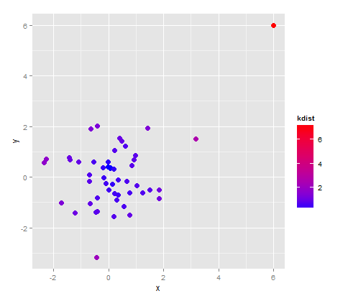
Outlier Score
Outlier Score = Measures extent to which an object is an outlier
Simple example = Distance to kth nearest neighbor

Slide 5
Density as an Outlier Score
Density = (Average distance to k-nearest neighbors)⁻¹

Slide 6
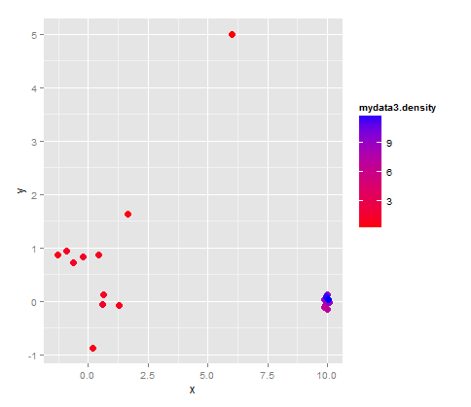
Density as an Outlier Score
Density = (Average distance to k-nearest neighbors)⁻¹

Slide 7
Average Relative Density

Slide 8
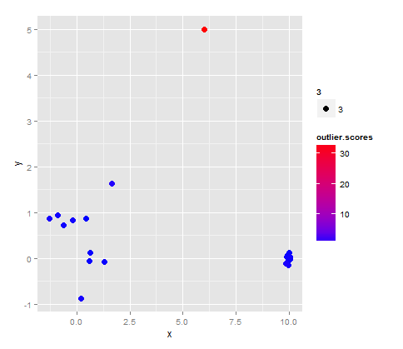
Average Relative Density

Slide 9
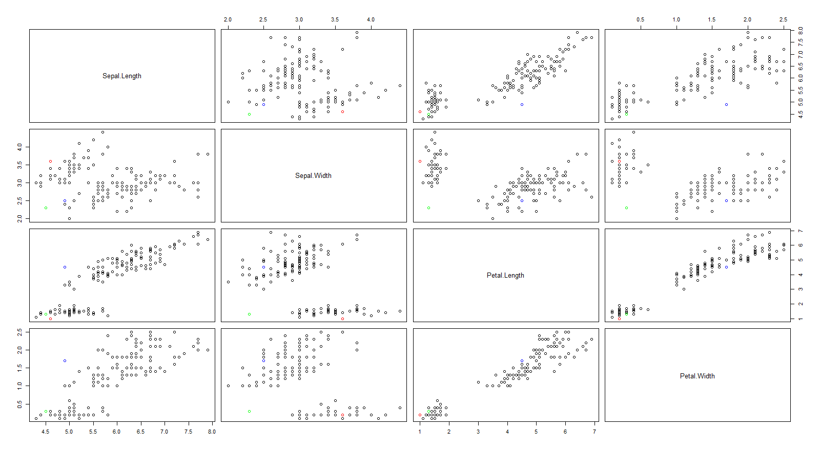
Local Outlier Factor for Iris Data

