Slide 1
Modeling the Impact of CAFOs on Nitrate Contamination of Water Wells
Jesse Crawford¹, Keith Emmert¹, and Kartik Venkataraman²
¹Department of Mathematics
²Department of Engineering and Computer Science
Tarleton State University
April 1, 2016

Slide 2
Concentrated Animal Feed Operations
Spatially concentrated livestock production
Manure loading rates can exceed absorptive capacity of land
Nitrogen based fertilizers
Irrigation
Possible Result: Nitrate contamination of nearby groundwater

Slide 3
Nitrate Contamination of Groundwater
Private wells on farms/ranches are used for drinking water
Health impacts of nitrate contamination
Blue-baby disease in infants (methemoglobinemia)
Miscarriages
Non-Hodgkin Lymphoma
Maximum Contaminant Level (MCL): 10 mg/L
Indicative of human inputs: 3 mg/L

Slide 4
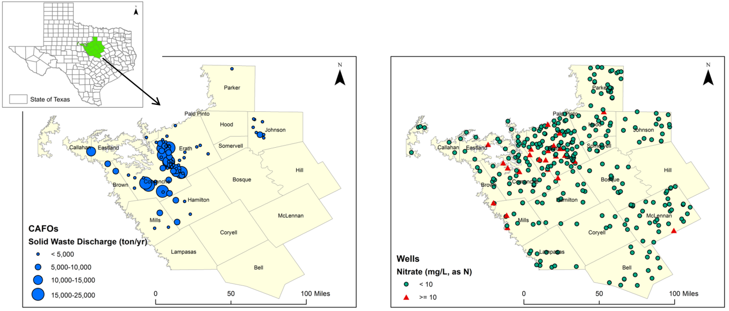

Slide 5
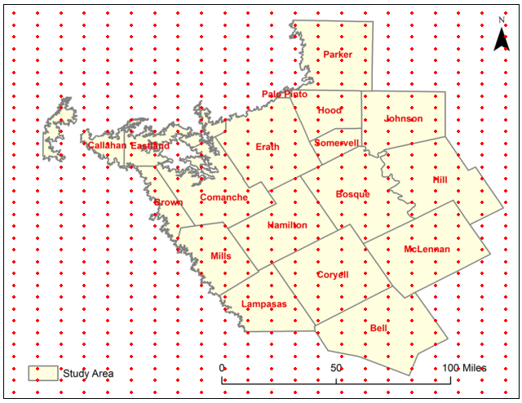
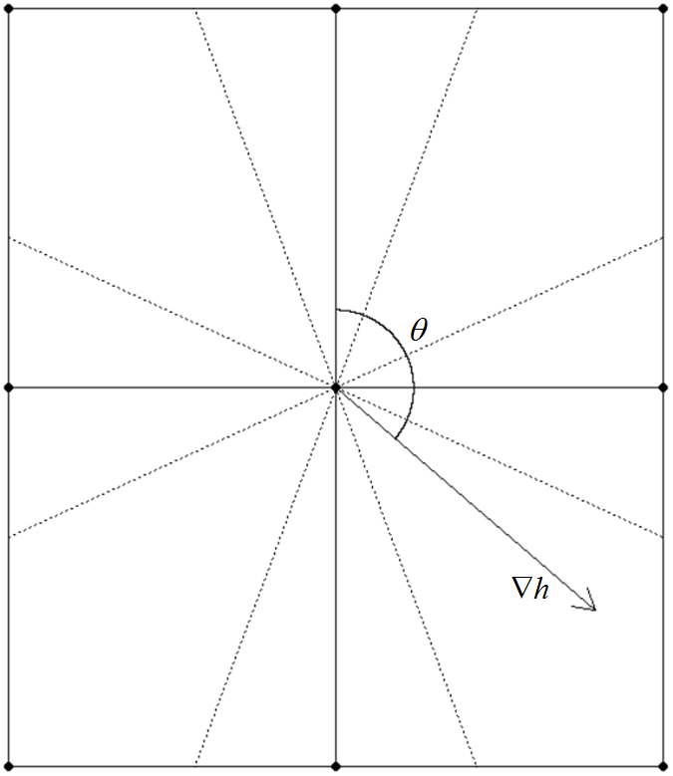
Hydraulic Gradient with GIS
Geographic Information System
348 x 466 Grid

Slide 6
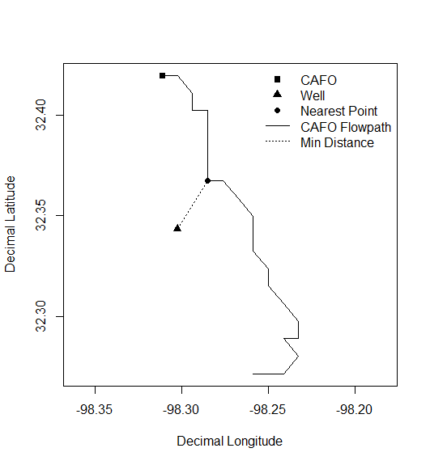
CAFO Flow Path

Slide 7
CAFO Migration Score (CMS)

Slide 8
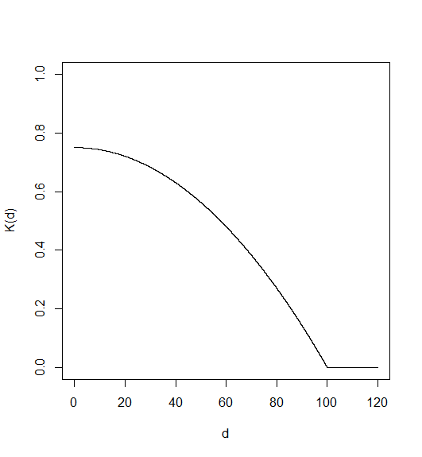
CAFO Migration Score (CMS)

Slide 9
Logistic Regression Model

Slide 10
Logistic Regression Model
Parameter | Estimate | Std. Error | z value | Pr(>│z│)
β₀ | -2.86 | 0.307 | -9.30 | 1.460E-20
β₁ | 1.65E-05 | 2.41E-06 | 6.85 | 7.187E-12

Slide 11
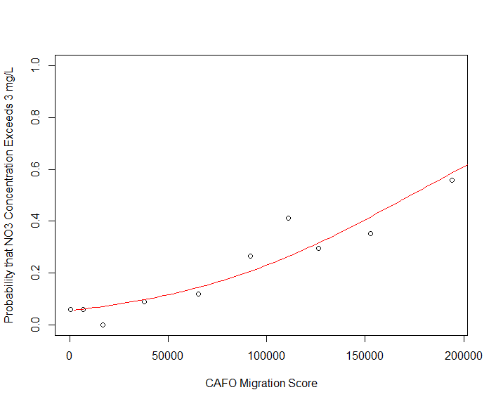
Logistic Regression Model
Hosmer-Lemeshow
Goodness-of-fit Test
p-value = 0.43

Slide 12
Probability Thresholds
Probability of Nitrate
Contamination
Data
Model

Slide 13
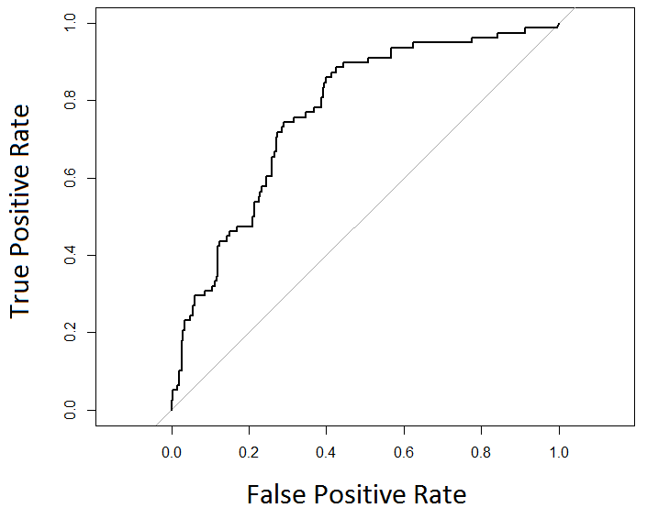
ROC Curve
Area under curve = 0.769

Slide 14
Future Research
Include more variables
Depth to Water Table
pH
Total Dissolved Solids
Model Improvements
Cross validation
Tune model parameters (kernel function, gamma)
Use other classification methods
Percent Clay
Percent Organic Matter
Annual Rainfall

Slide 15
References
Burkartaus, D.M.R., and Stoner, J.D. (2008). “Nitrogen in Groundwater Associated with Agricultural Systems.” In Nitrogen in the Environment: Sources, Problems and Management; ed. J.L. Hatfield and R.F. Follett. Publications from USDA-ARS/UNL Faculty, Paper 259.
Harter, T., Davis, H., Matthews, M.C., and Meyer, R.D. (2002). “Shallow Groundwater Quality on Dairy Farms with Irrigated Forage Crops.” J. Contam. Hydrol., 55, 287-315.
Hechenbichler K. and Schliep K.P. (2004). “Weighted k-Nearest-Neighbor Techniques and Ordinal Classification”, Discussion Paper 399, SFB 386, Ludwig-Maximilians University Munich (Dec 20, 2014).
Hosmer, D., Lemeshow, S., and Sturdivant, R. (2013). Applied Logistic Regression, 3rd ed. John Wiley and Sons, Inc., Hoboken, NJ.

Slide 16
References
Lockhart, K.M., King, A.M., and Harter, T. (2013). “Identifying Sources of Groundwater Nitrate Contamination in a Large Alluvial Groundwater Basin with Highly Diversified Intensive Agricultural Production.” J. Contam. Hydrol., 151, 140-154.
Mace, R.E., Chowdhury, A.H., Anaya, R., and Way, S.C. (2000). “A Numerical Groundwater Flow Model of the Upper and Middle Trinity Aquifer.” Hill Country Area: Texas Water Development Board Open File Report 00-02.
McFarland, A., and Adams, T. (2007). “Semiannual Water Quality Report for the North Bosque River Watershed”. Texas Institute for Applied Environmental Research Technical Report 0701.
McFarland, A. and Hauck, L. (1997). “Livestock and the Environment: A National Pilot Project Report on Stream Water Quality in the Upper North Bosque River Watershed.” Texas Institute for Applied Environmental Research Progress Report 97-03.

Slide 17
References
Muller, D.A., and McCoy, J.W. (1987). Groundwater Conditions of the Trinity Group Aquifer in Western Hays County. Texas Water Development Board.
Nolan, B.T. (2001). “Relating Nitrogen Sources and Aquifer Susceptibility to Nitrate in Shallow Ground Waters of the United States.” J. Groundwater, 39(2), 290-299.
Pederson, C.H., Kanwar, R., Helmers, M.J., and Mallarino, A.P. (2011). “Impact of Liquid Swine Manure Application and Cover Crops on Ground Water Quality.” Iowa State Research Farm Progress Reports, Paper 77.
Rekha, P., Kanwar, R.S., Nayak, A.K., Hoang, C.K., and Pederson, C.H. (2011). “Nitrate Leaching to Shallow Groundwater Systems from Agricultural Fields with Different Management Practices.” J. Environ. Monit., 13, 2550-2558.

Slide 18
References
Texas Commission on Environmental Quality (2014). Water Quality General Permits Search. (Mar 06 2014).
Texas Water Development Board (2014). TWDB Groundwater Database Reports. (Mar 06 2014).
Texas Water Development Board (2014). Water for Texas – 2012 State Water Plan. Texas Water Development Board, Austin, TX.
Twarakavi, N.K.C., and Kaluarachchi, J.K. (2005). “Aquifer Vulnerability Assessment to Heavy Metals using Ordinal Logistic Regression.” Groundwater, 43, 200-214.
Venkataraman, K., and Uddameri, V. (2012). “Modeling Simultaneous Exceedance of Drinking-water Standards of Arsenic and Nitrate in the Southern Ogallala Aquifer using Multinomial Logistic Regression.” J. Hydrol., 458-459, 16-27.

Slide 19
Thank You!

