Slide 1
Math 5364/66 Notes Installing Python Modules
Jesse Crawford
Department of Mathematics
Tarleton State University

Slide 2
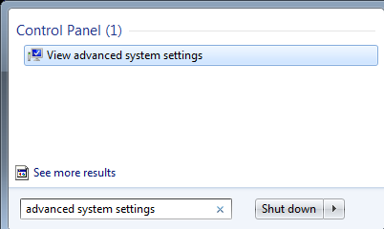
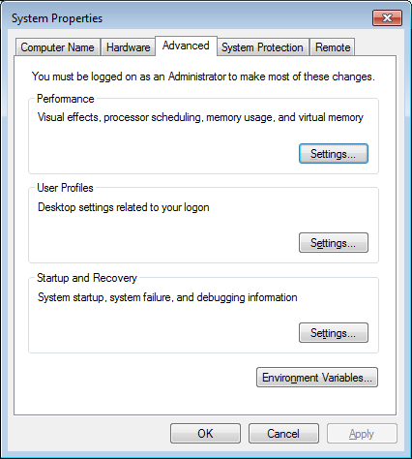
Adding Anaconda to Path Variable

Slide 3
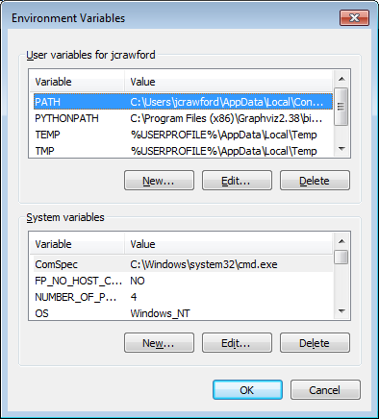
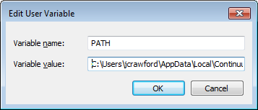
Make sure the following directories are present:
C:\Users\<your user name>\AppData\Local\
Continuum\Anaconda;
C:\Users\< your user name >\AppData\Local\
Continuum\Anaconda\Scripts;

Slide 4
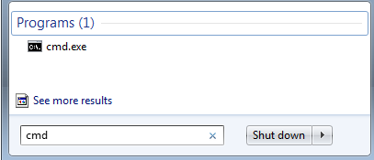
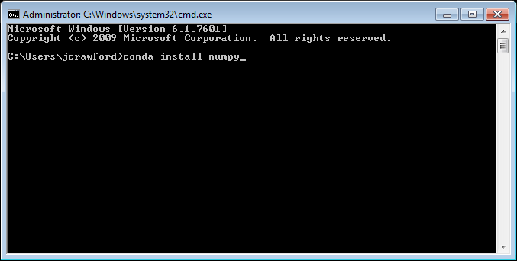
Installing Modules with Conda
Find packages at
https://conda.binstar.org/

Slide 5
Installing Modules with Pip

Slide 6
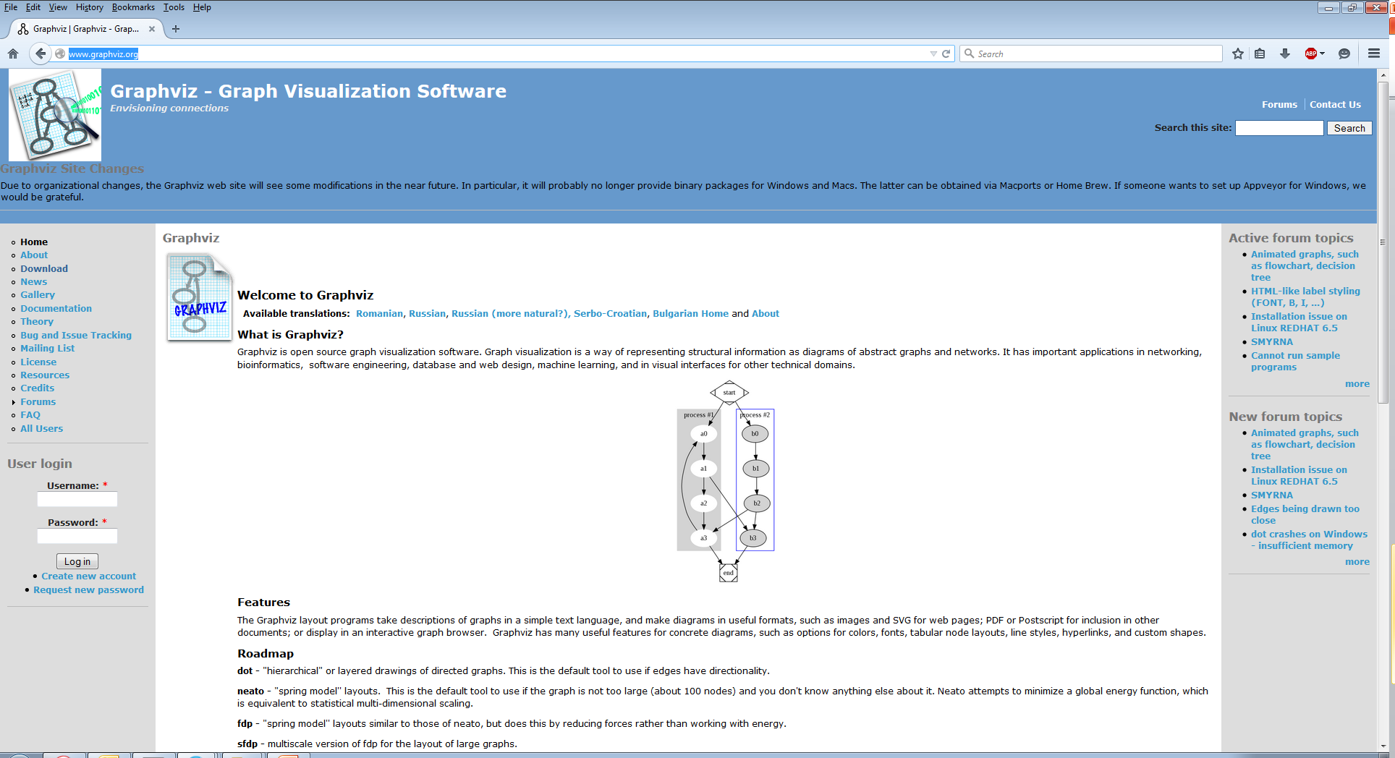
Graphviz
http://www.graphviz.org/

Slide 7
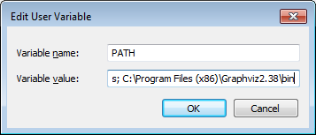
Add Graphviz to Path Also

Slide 8
A Problem with Pyparsing
Error message: "Couldn't import dot_parser,
loading of dot files will not be possible"
Solution:
pip uninstall pyparsing
pip install –Iv https://pypi.python.org/packages/source/p/pyparsing/pyparsing-1.5.7.tar.gz#md5=9be0fcdcc595199c646ab317c1d9a709 pip install pydot

Slide 9
Plotting Decision Trees: Technical Problems
Solutions for Windows 7 (64-bit)
Use Python 2 not Python 3
Install Graphviz and Add Graphviz to Path variable
Install pip, uninstall pyparsing, and reinstall pyparsing
Install pydot from proper directory

Slide 10
