Slide 1
Math 5364/66 Notes Image Recognition with Eigenfaces
Jesse Crawford
Department of Mathematics
Tarleton State University

Slide 2
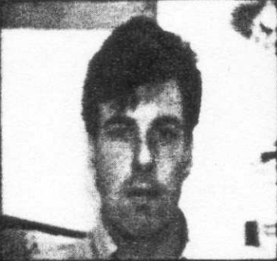

Slide 3
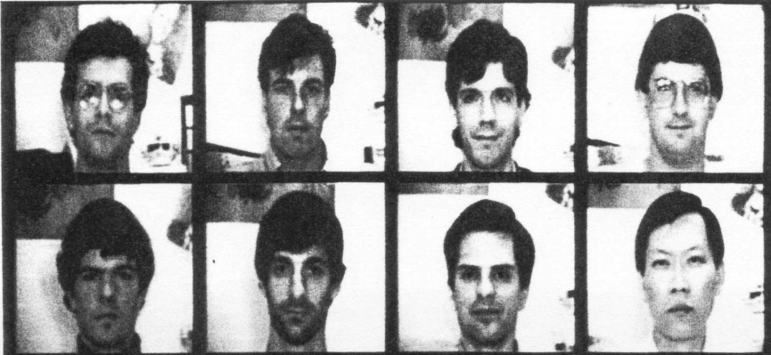
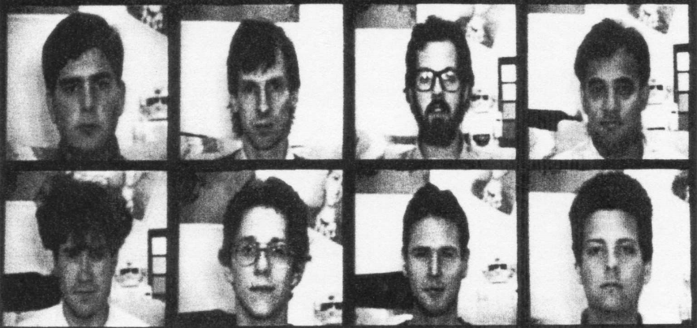

Slide 4
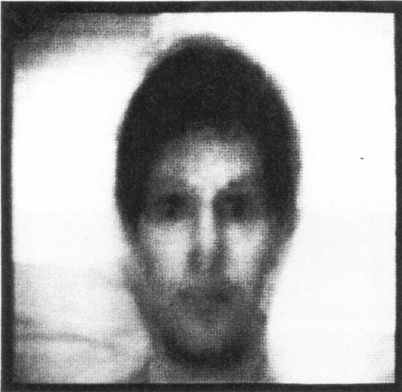

Slide 14
