Slide 1
Ma h
Tarleton State University
Department of
Mathematics
Michael Warren, John Gresham, and Bryant Wyatt

Slide 2
Ma h
Graphical Solutions of the General Cubic Function

Slide 3
Ma h
$$x^{2}+4=0$$
Solutions exist and should be recognized as non-real by calculus students. What connections can be made on the traditional graphical representation of the function?

Slide 4
Ma h
2D graphical representation showing the quadratic and the two non-real solutions equidistant from the vertex to the real axis.
Quadratic Illustrator

Slide 5
Ma h
$$x^{3}+x^{2}−2x=0$$
Three real, rational roots. Easily found from the graphical representation.

Slide 6
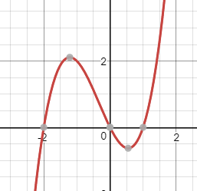
Ma h
Graphical representation of the previous cubic.

Slide 7
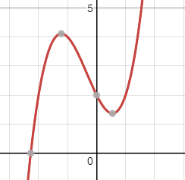
Ma h
$$x^{3}+x^{2}−2x+2=0$$
We can identify the number of real and non-real roots for this equation from the graphical representation. Can we visualize these roots in the graphical representation?

Slide 8
Ma h
Any cubic equation can be reduced to the form
$$x^{3}+px+q=0$$
The Cardano formula for the roots has the form
$$x=\sqrt[3]{−\frac{q}{2}+\sqrt{\frac{q^{2}}{4}+\frac{p^{3}}{27}}}+\sqrt[3]{−\frac{q}{2}−\sqrt{\frac{q^{2}}{4}+\frac{p^{3}}{27}}}$$
Then one must choose $α$ and $β$,
$$α=\sqrt[3]{−\frac{q}{2}+\sqrt{\frac{q^{2}}{4}+\frac{p^{3}}{27}}}$$
$$β=\sqrt[3]{−\frac{q}{2}−\sqrt{\frac{q^{2}}{4}+\frac{p^{3}}{27}}}$$
such that $αβ=−\frac{p}{3}$.

Slide 9
Ma h
Graphical method
GeoGebra Demonstration
Notes:
When working with real functions, the standard way of graphing is to place two real number lines orthogonal to each other. Then choose one line to represent all the inputs (usually the horizontal) and the other line to represent the outputs of the function. This creates a nice 2-D visualization of how a function manipulates inputs.

Slide 10
Ma h
How do the methods connect to 3D cubics?
3D Cubic Illustrator

Slide 11
Ma h
Thank You
Michael Warren
mwarren@tarleton.edu
John Gresham
jgresham@tarleton.edu
http://faculty.tarleton.edu/jgresham/ictcm/ictcm_index.html
Bryant Wyatt
wyatt@tarleton.edu

